Slide 1

Tableau Slides
By: Pooja Gupta

Slide 2
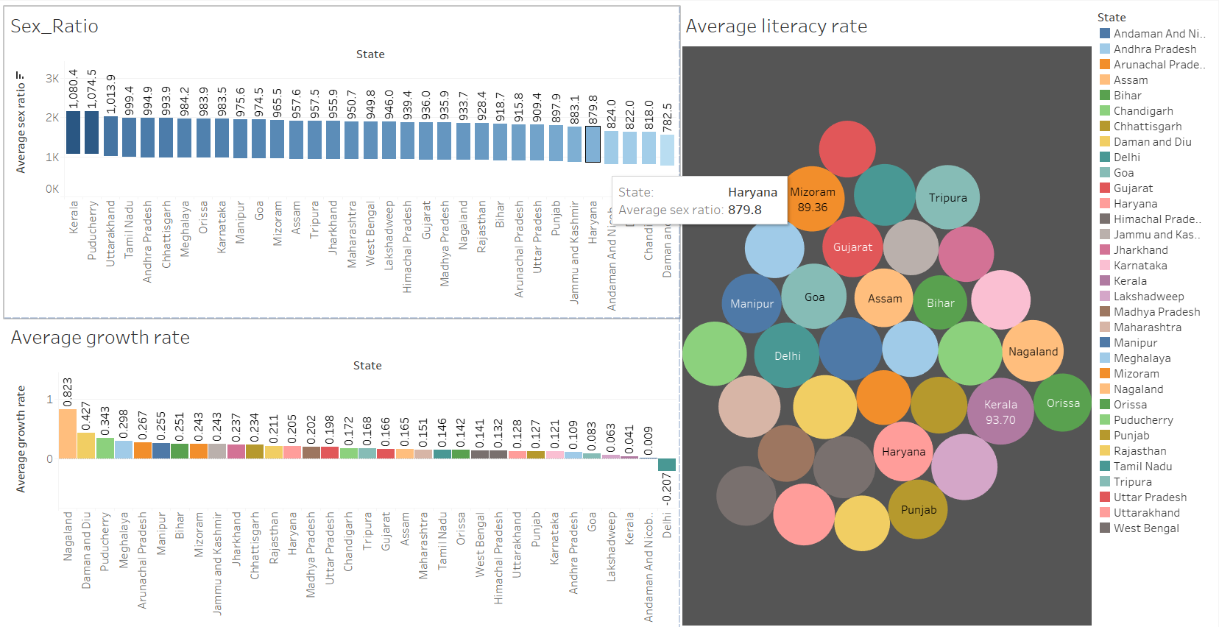
Average Literacy rate, growth rate and sex Ratio

Slide 3



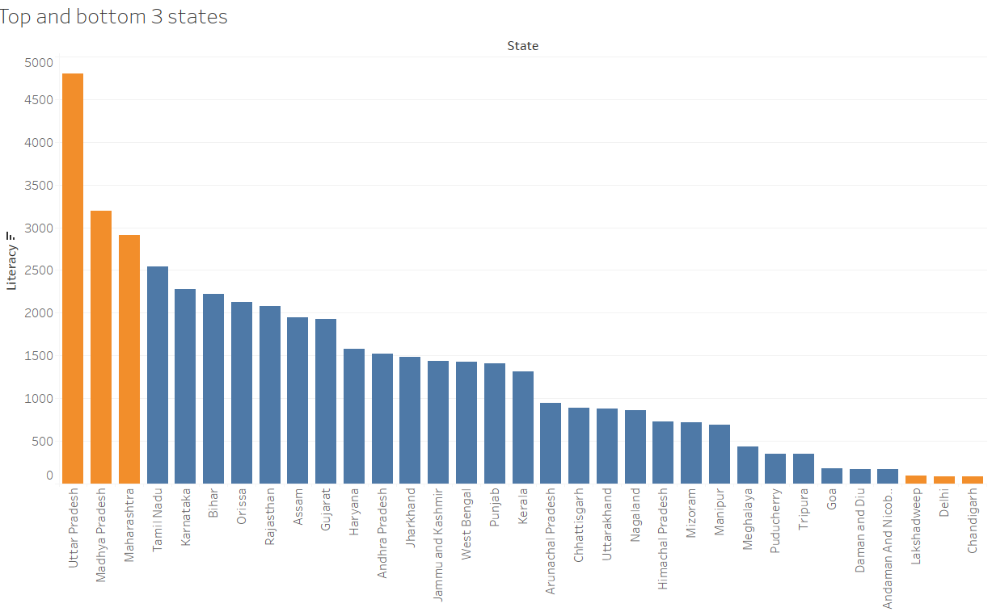


Top and Bottom three states for Literacy

Slide 4
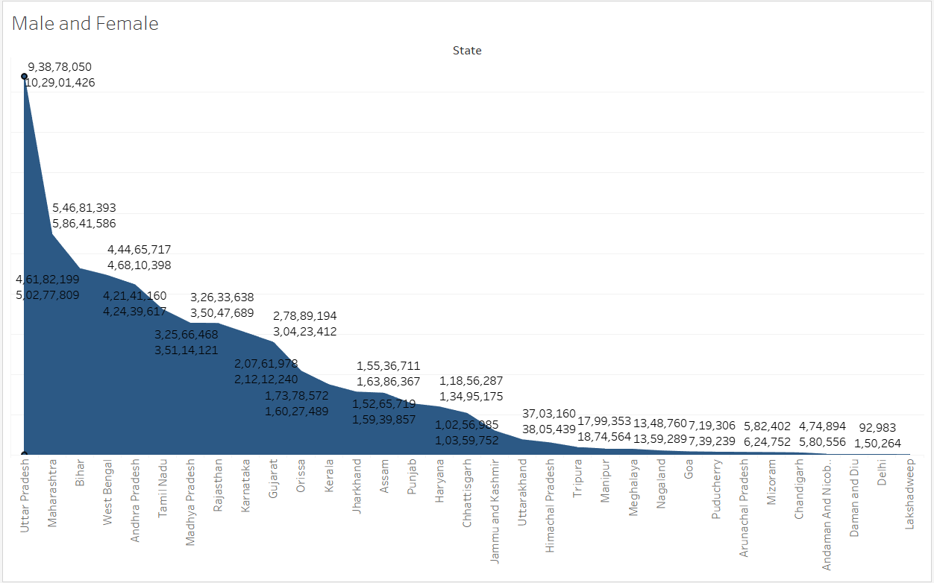
Total Male and Female

Slide 5
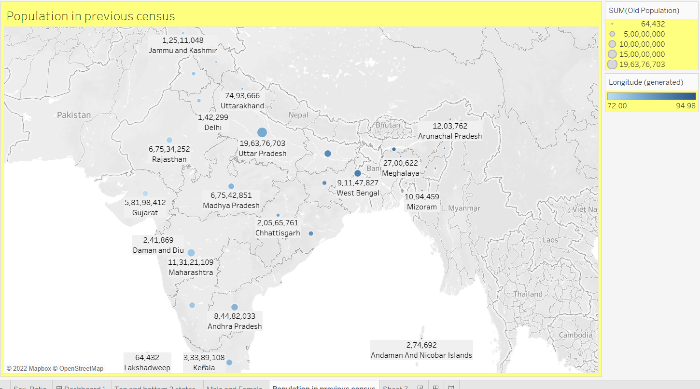
Population in Previous Census

